Slide 1


Lecture 3
Random Variable

Slide 2
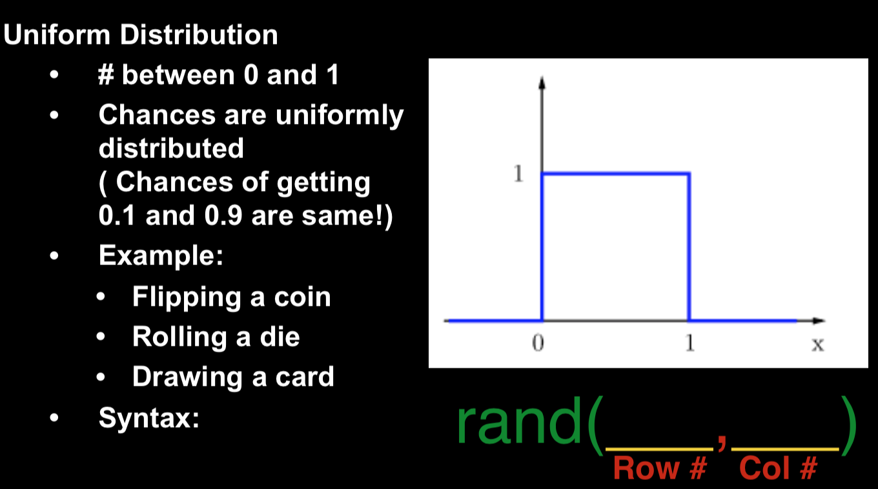
Uniformly Distributed Random Variable

Slide 3
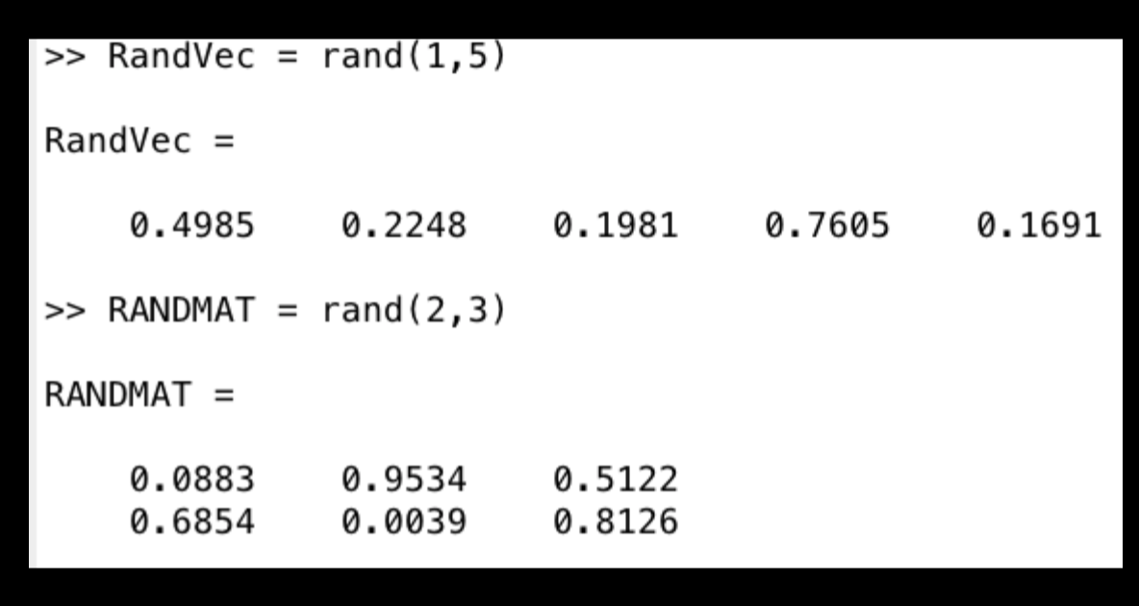
Uniformly Distributed Random Variable

Slide 4
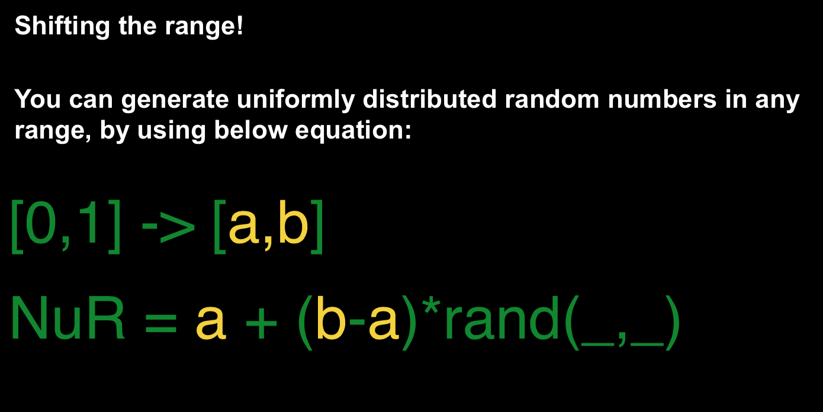
Uniformly Distributed Random Variable

Slide 5
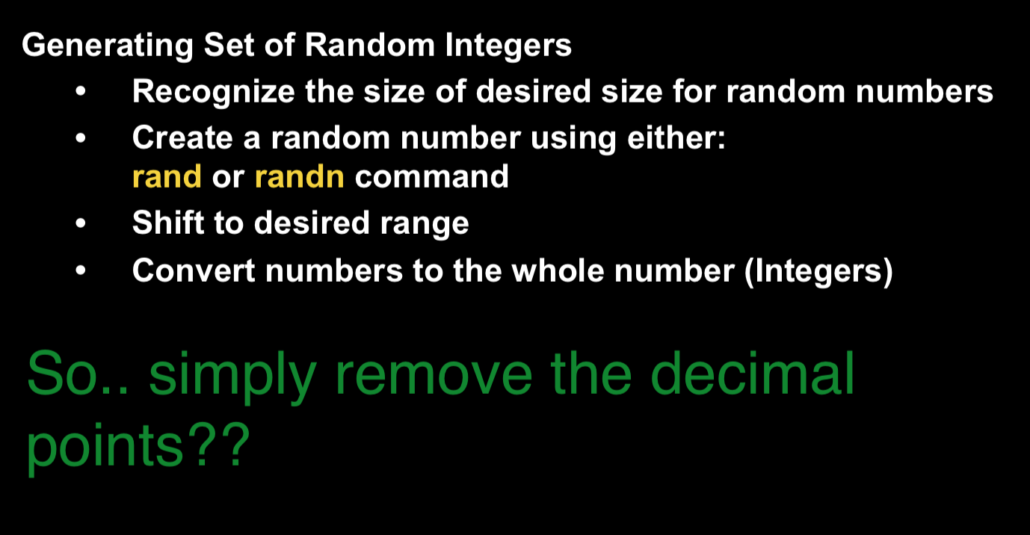
Random Integer

Slide 6
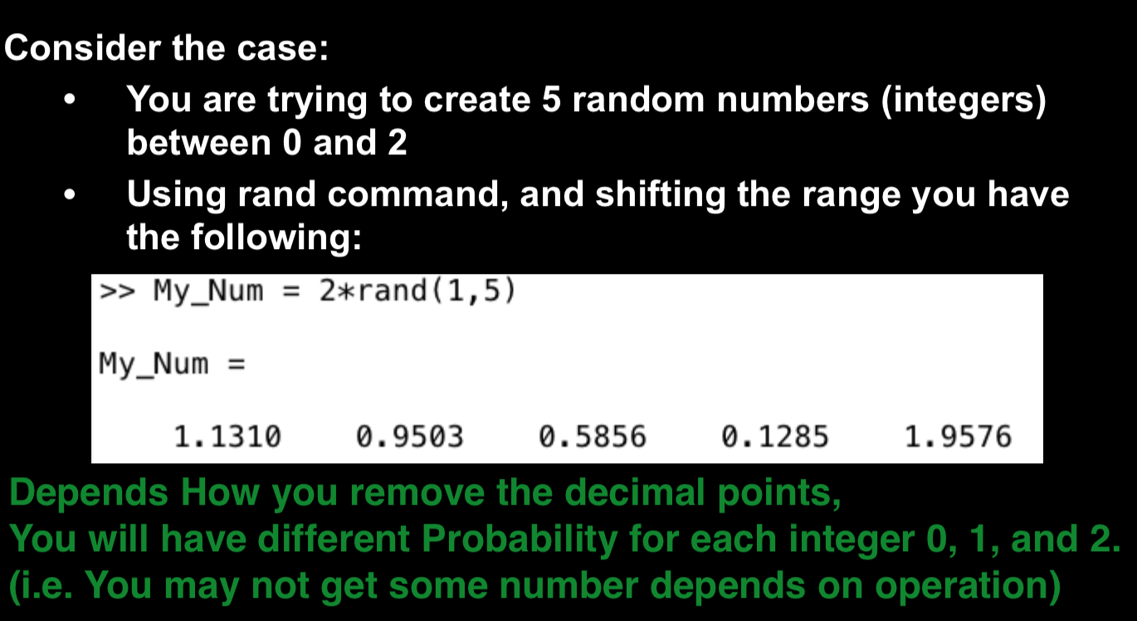
Random Integer

Slide 7
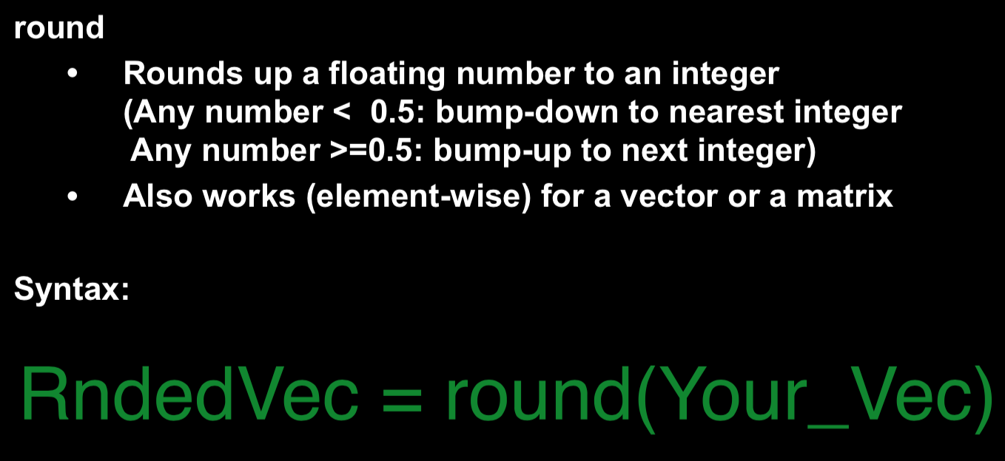
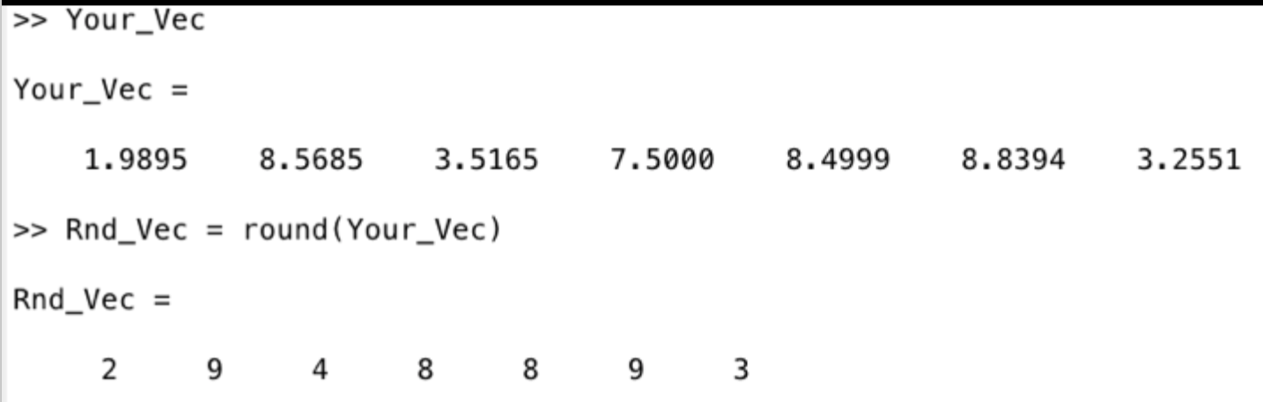
Random Integer

Slide 8
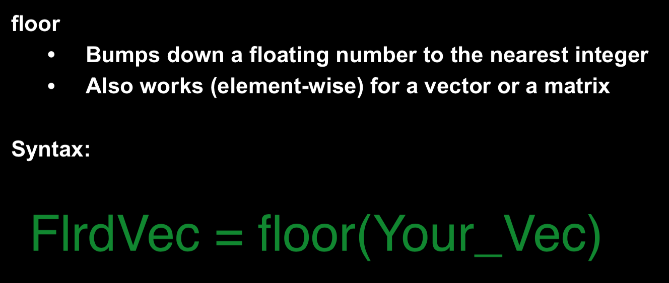
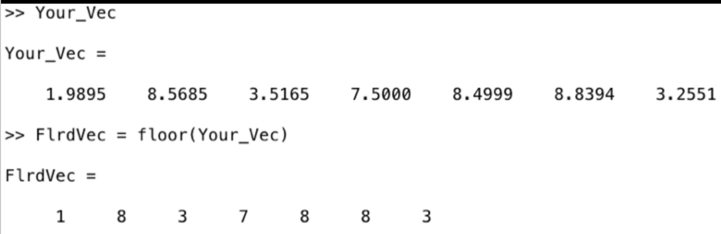
Random Integer

Slide 9
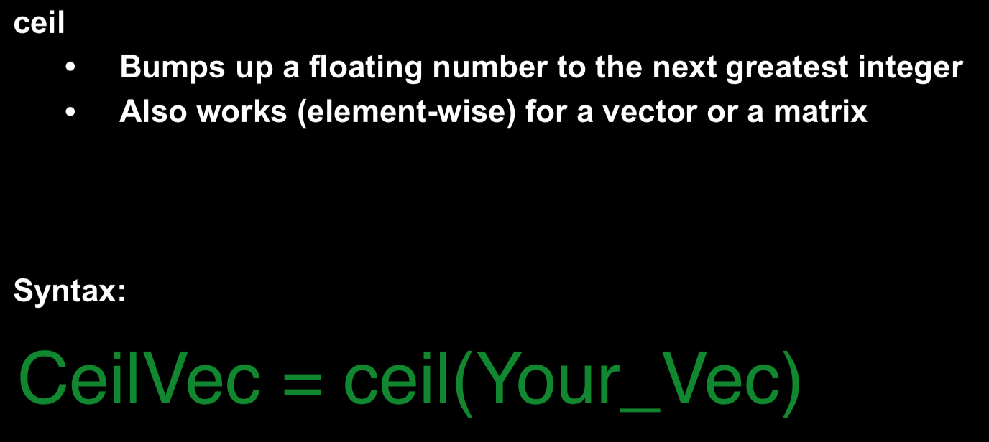
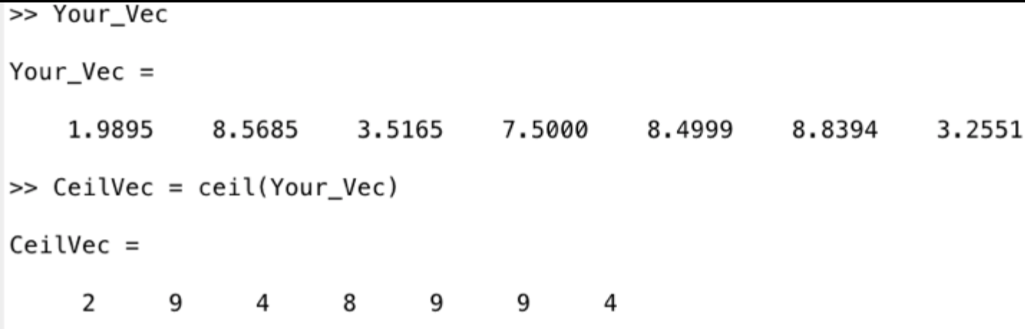
Random Integer

Slide 10
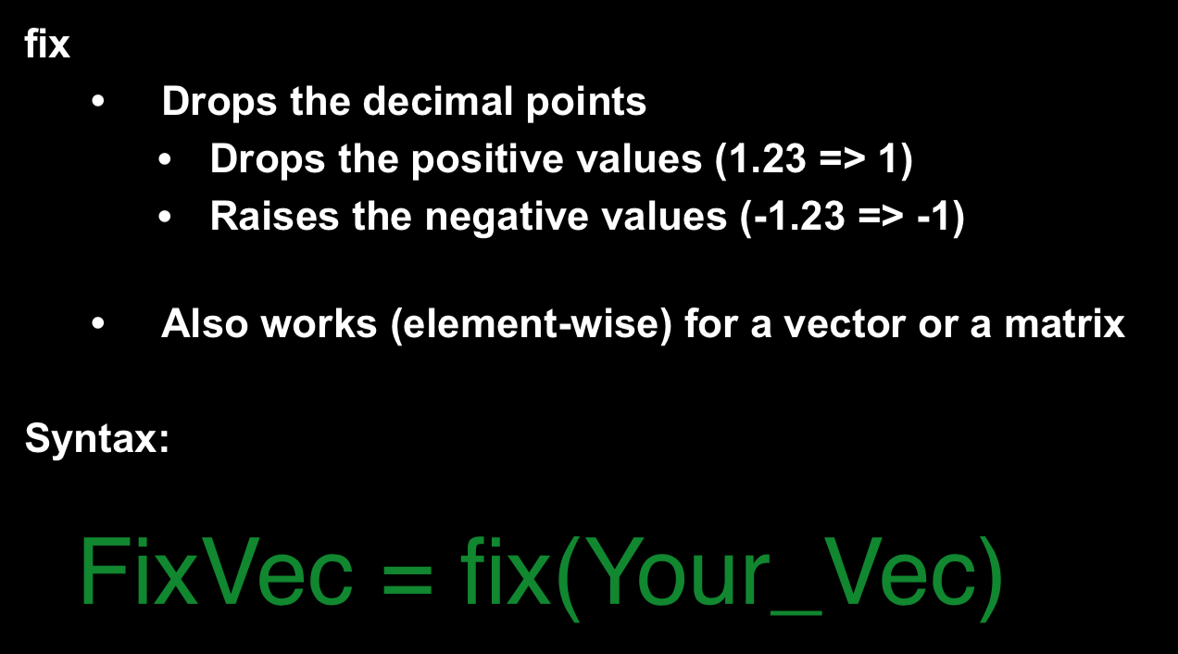
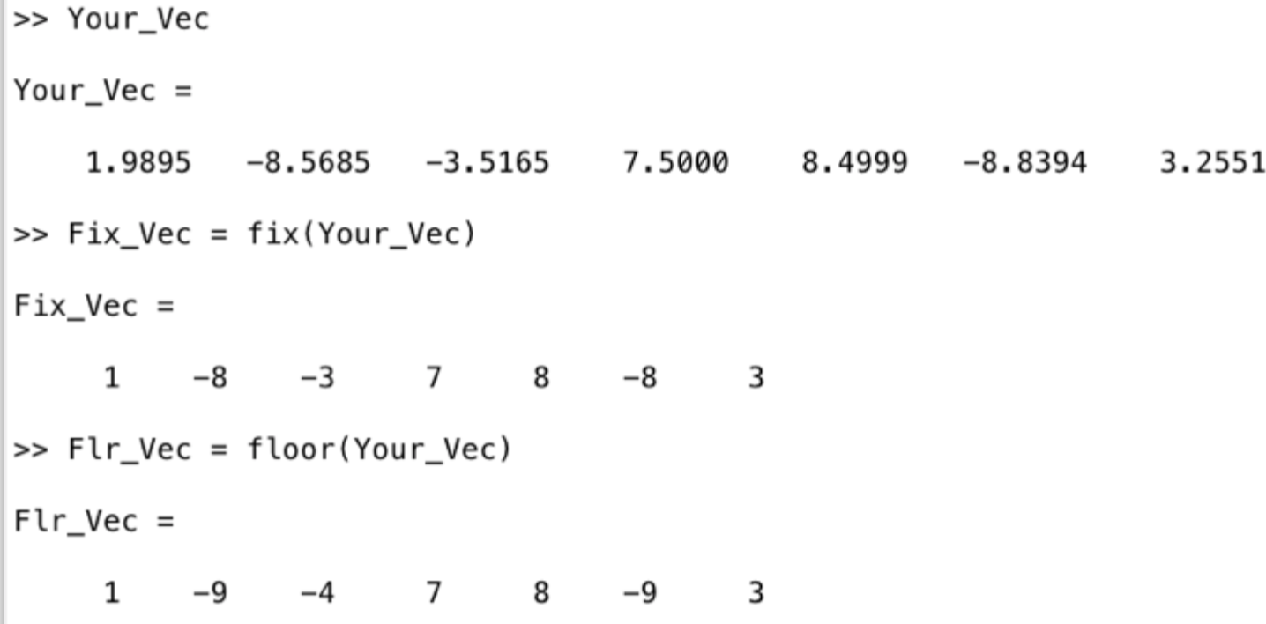
Random Integer

Slide 11
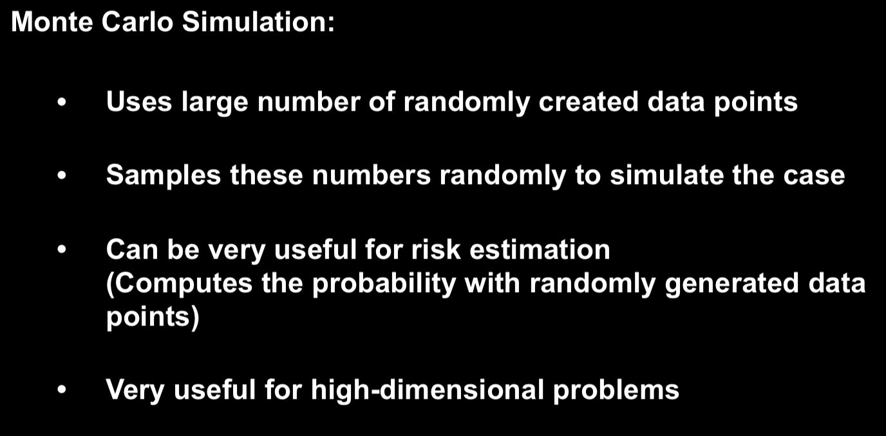
Monte Carlo Simulation
*Examples:
Estimating Probability
Estimating Area

Slide 12
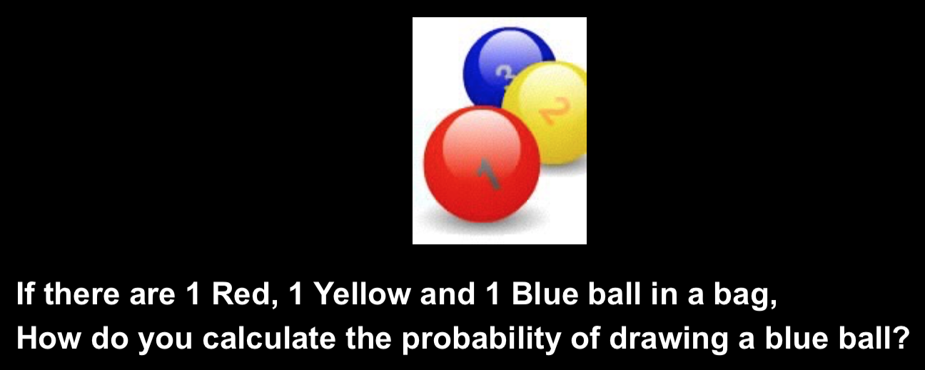
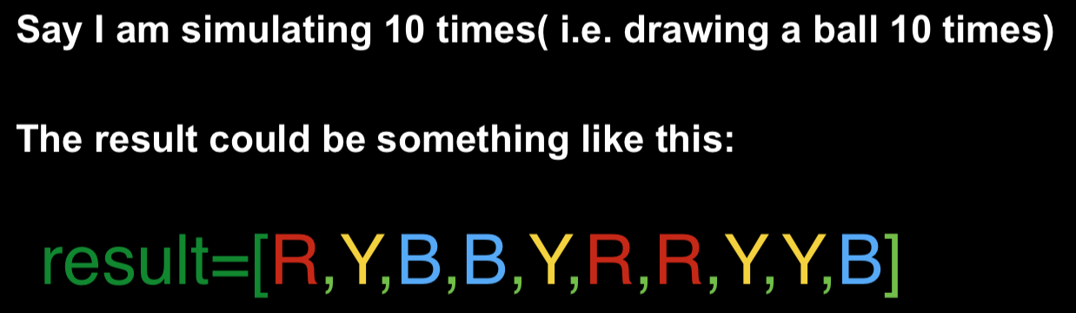
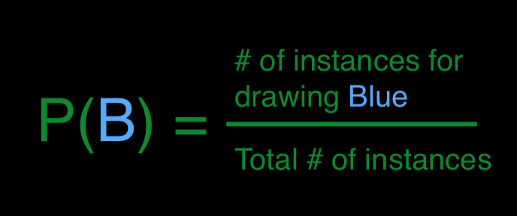
Monte Carlo Simulation
Estimating Probability

Slide 13
Monte Carlo Simulation
Let’s give number to the event!
Red : 1
Blue: 2
Yellow: 3
Then the result of 10 simulations may be represented as:
result = [1,3,2,2,3,1,1,3,3,2]

Slide 14
Monte Carlo Simulation
We can now simulate this in MATLAB!
Create 1 x (num. of Trial) row vector containing random number from 1 to 3
Form a logical array imposing condition
(In this example: Number of events when blue ball ( or number 2) is drawn)
Count how many ‘hits’, using nnz(logical array)
Calculate the probability using equation

Slide 15
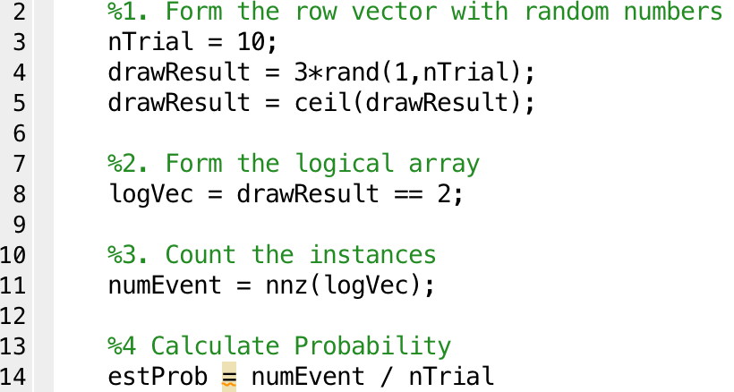
Monte Carlo Simulation

Slide 16
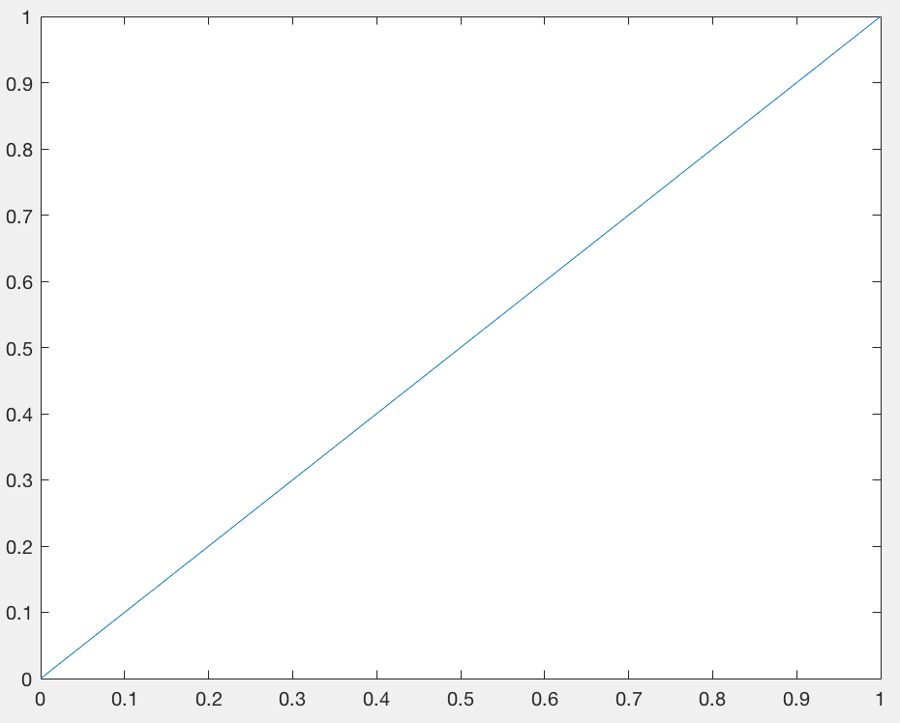
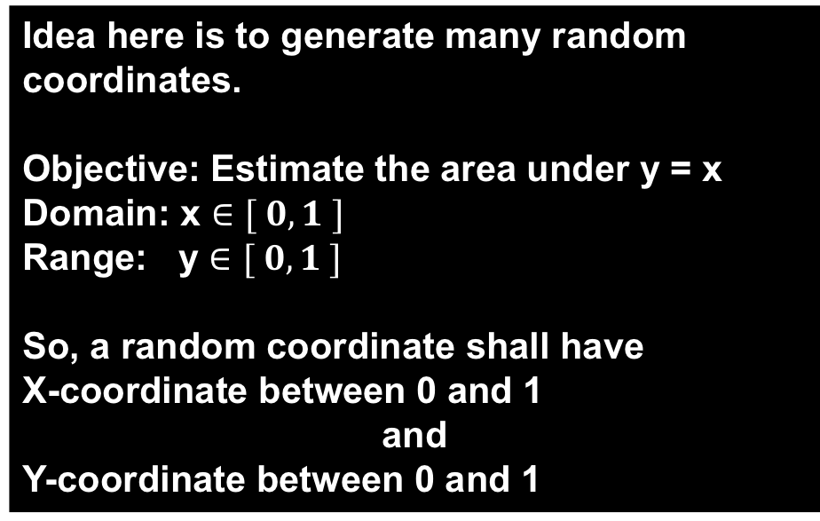
Monte Carlo Simulation
2. Estimating Area

Slide 17
Monte Carlo Simulation
Create two 1 x (num. of Trial) row vectors (x, y coordinate) containing random number from 0 to 1
(This may vary depends on domain and range)
Find a threshold point (y value on the function)
Form a logical array imposing condition
(In this example: Number of y-coordinate that landed under the threshold value)
Count how many ‘hits’, using nnz(logical array)
Calculate the fraction!
Multiply the whole area and compute the area

Slide 18
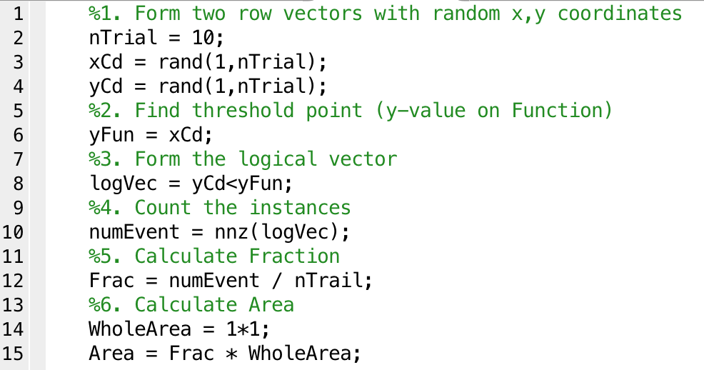
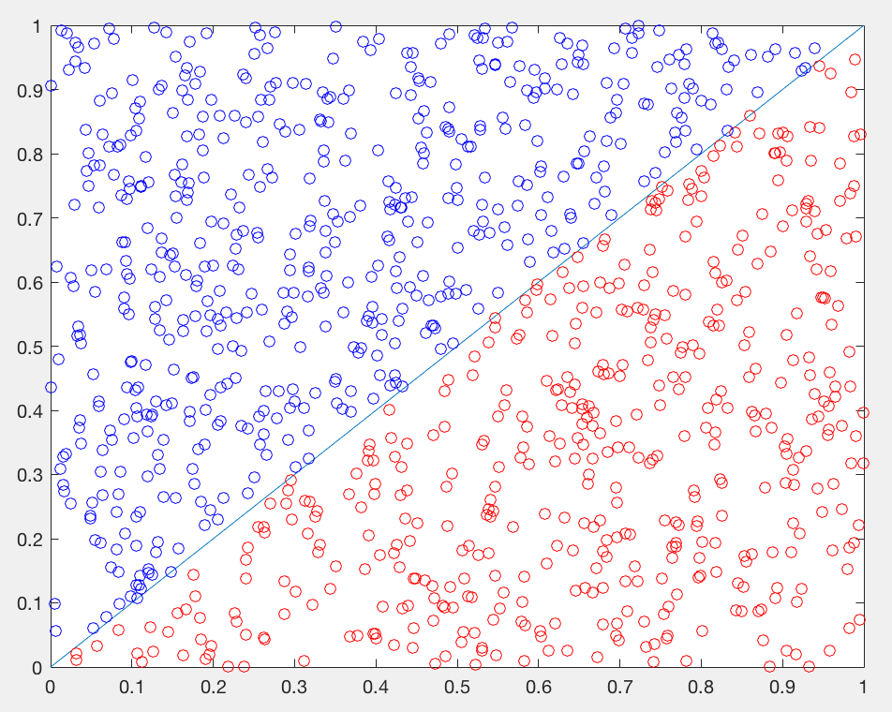
Monte Carlo Simulation

Slide 19

Exercise 1
1. Simulate to calculate the probability of getting 6 when rolling 1 die
2. Simulate to calculate the probability of having same face when rolling 2 dice
3. Simulate to calculate the probability of having either even number face or face of 1 when rolling a die.

